Slide 1
Smart ATM
Group 2
Abdulrahman Altami Mohammed Almarzooq Saleh Altasan Ali Althawab Ali Alsamanni

Slide 2
We will talk about
Introduction.
New features.
Reasons.
Details ad steps on project implementation
Constrains and difficulties.
UI
Class diagram

Slide 3
Introduction
System of ATM.
Smart ATM.
Smart features
Smartphone login by multiple way
Recognize a wanted person.
Auto failure alert

Slide 4
2. Features
Smart login
face recognition, fingerprint, card or with smart phone
Open new account
Currency exchange
CCTV
Recognize a wanted person
Auto failure alert

Slide 5
3. Reasons
Reason
To Improve several aspects in ATMs.
Security
We want to improve the security in ATMs.
Authentication
We want to provide many authentication methods to adapt modern technology.
All in one ATM
To minimize your need to go to the bank.
Main goal
Move ATMs to the next level.

Slide 6
4. Details and steps used to complete the project
This section details the methods we used to divide the work between our team members.
The way we divided the work was very fluid.
How this works, the leader provides a detailed a list of tasks that each team member can take, and each task was evaluated to approximately the same amount of work for each team member.
After the list is sent to the team members a meeting is scheduled and during the meeting, we discuss the details of the tasks, and each member is assigned to a one.

Slide 7
5. Constrains and difficulties
This project like many other has a lot of difficulties and constrains, these include:
The ATM has an abundant of complex device that are tied closely together that makes it harder to maintain.
The cost of both constructing and maintaining the machine will be higher compared to traditional ATMs
The machine should be at one of the bank major branches.
Having the ATM on the ladies' section will require the removal of the face ID feature.
Implementing a user-friendly UI may limit the innovation of the design team.

Slide 8
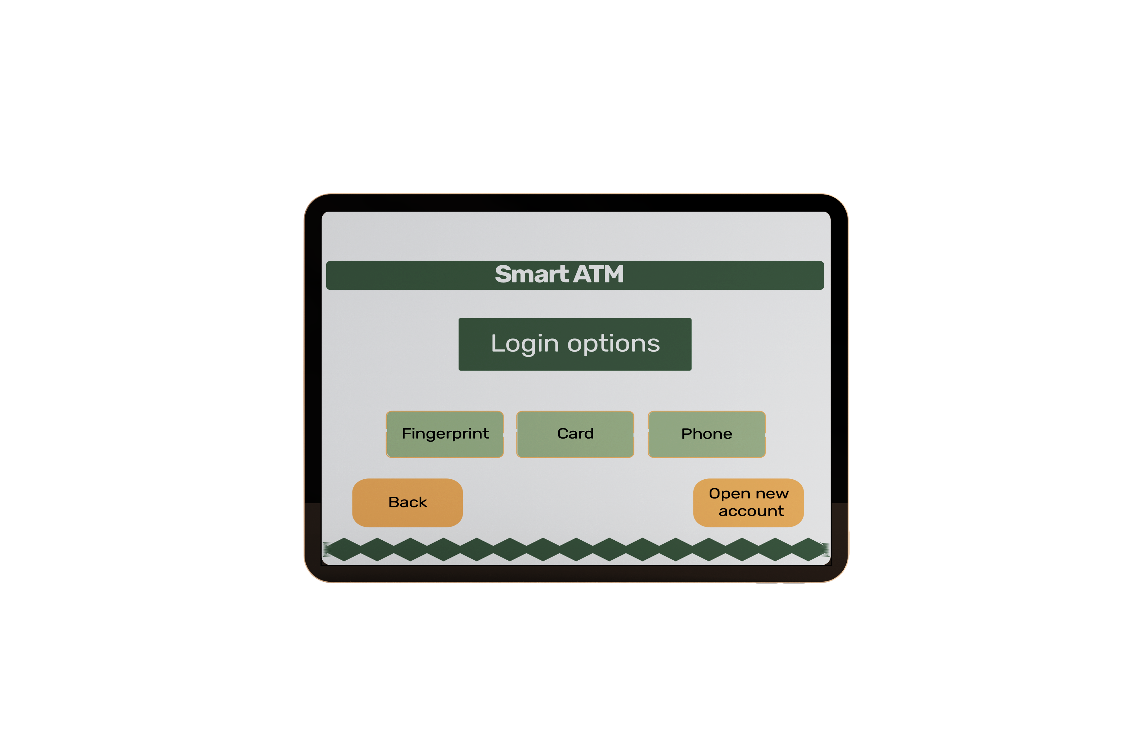
6. UI

Slide 9
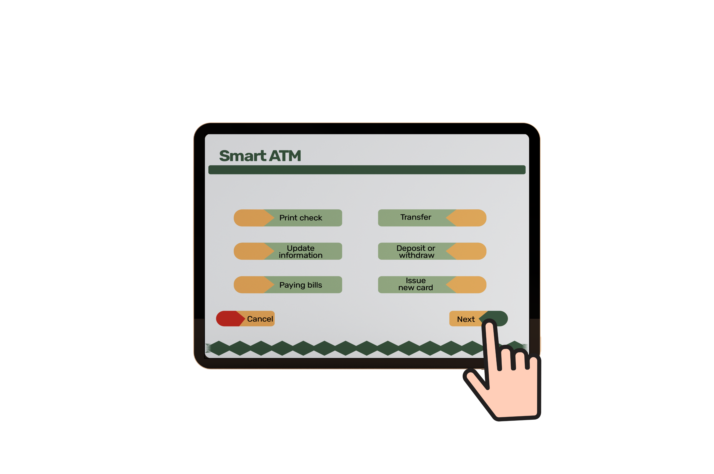
6. UI

Slide 10
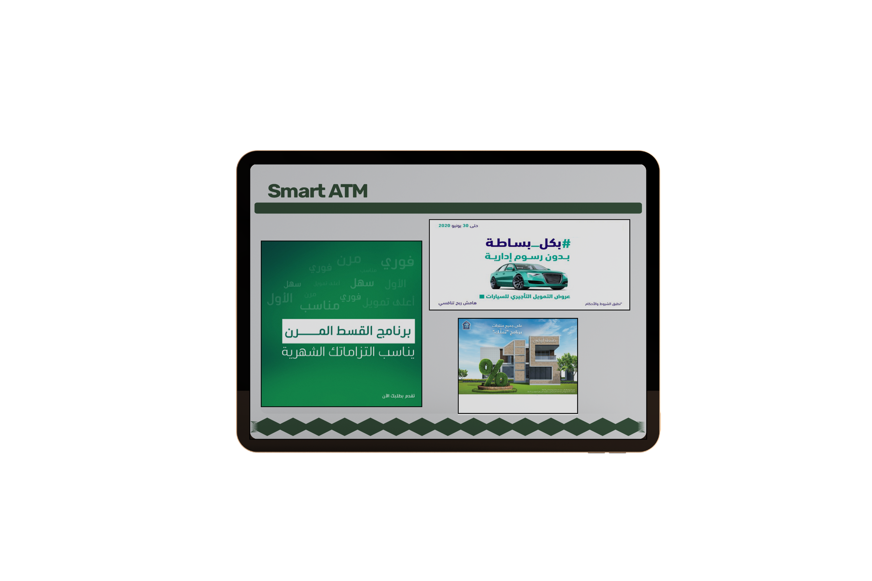
6. UI

Slide 11
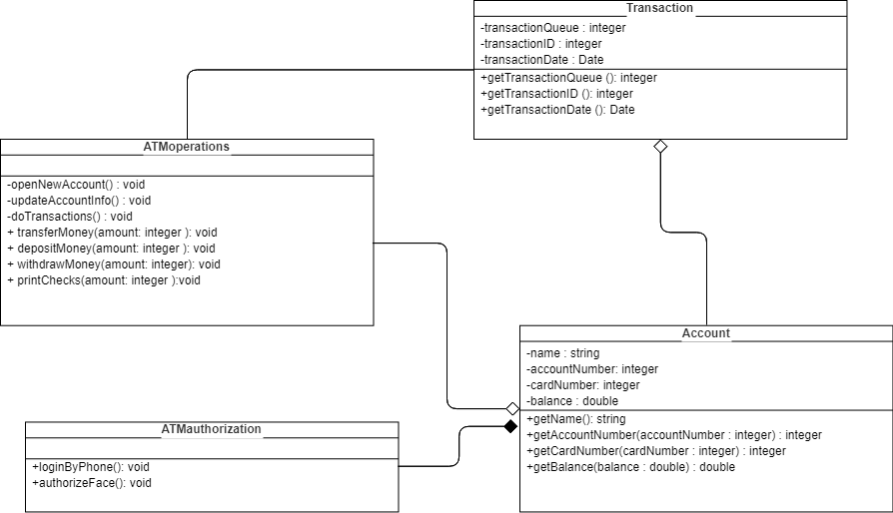
7. Class Diagram

Slide 12
Thank you for listening
Any Questions?

